Slide 1


Predicting Data Science Salaries

Slide 2
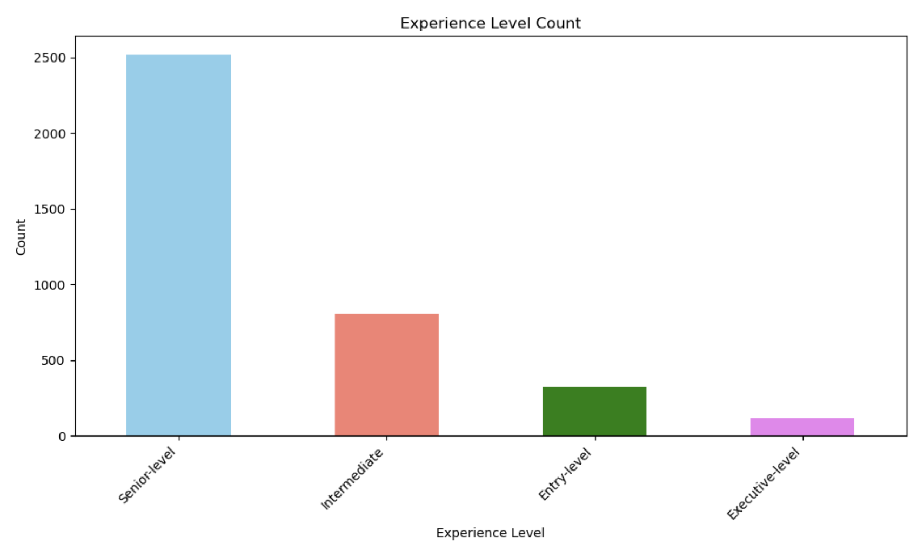
Count of number of Entries for Each Experience Level
Experience

Slide 3
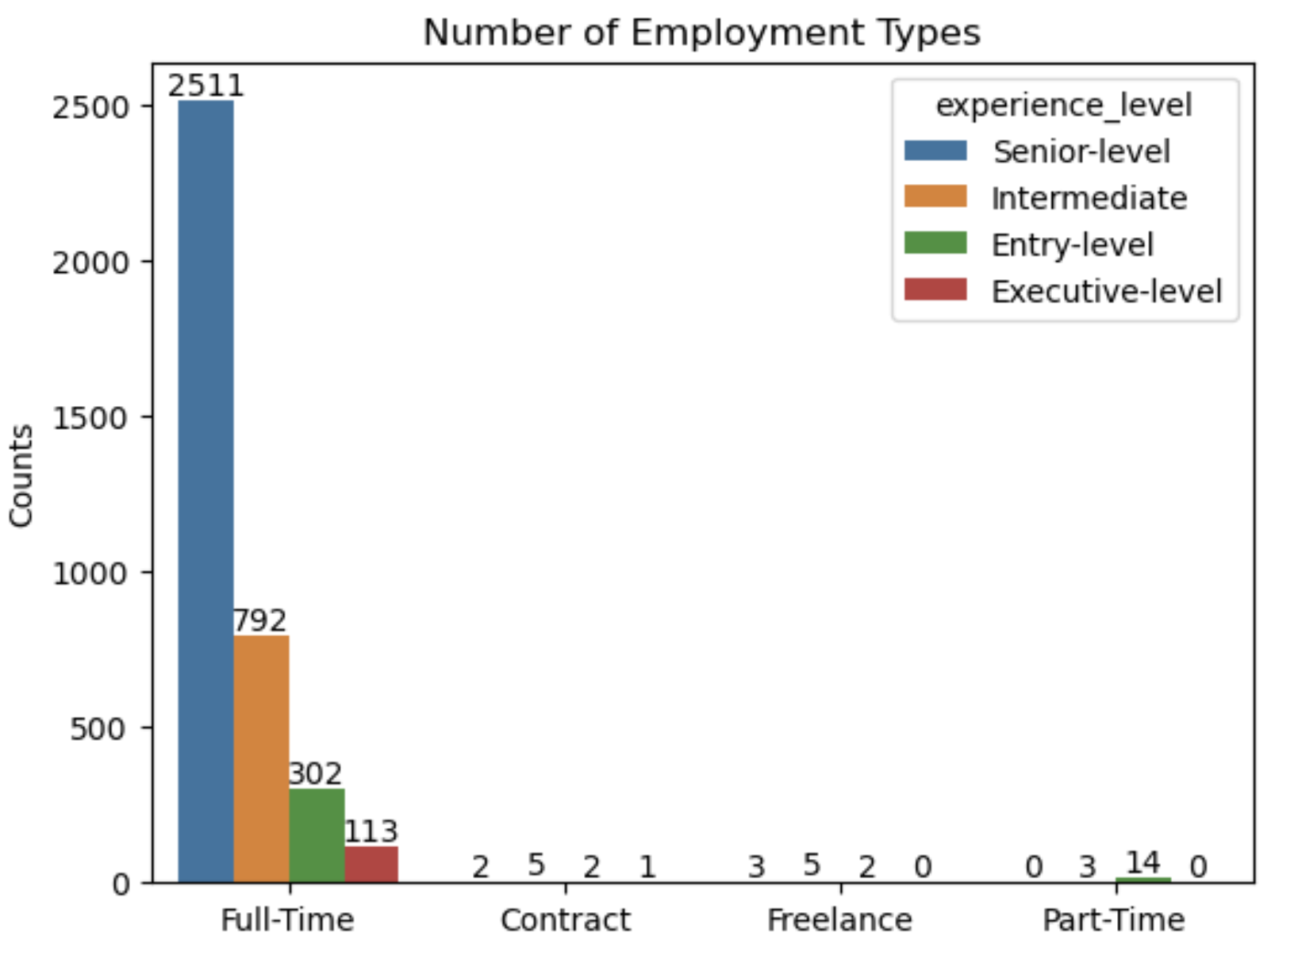
Count of Employment Type by Experience Level

Slide 4

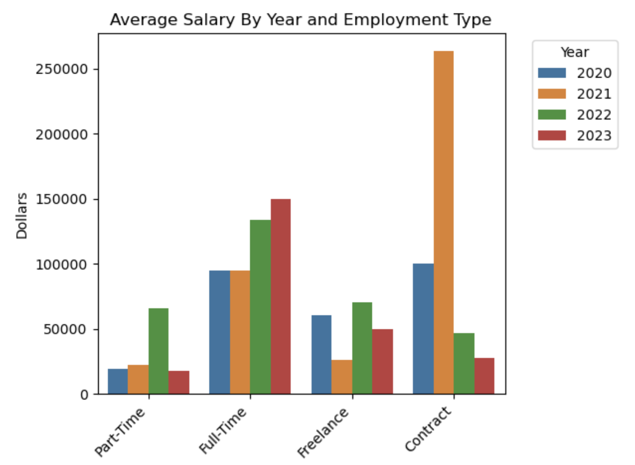



Average Salary by Year and Employment Type

Slide 5
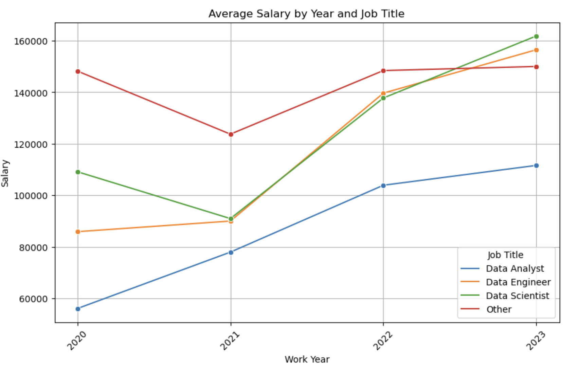
Average Salary By Year and Job Title

